Slide 1
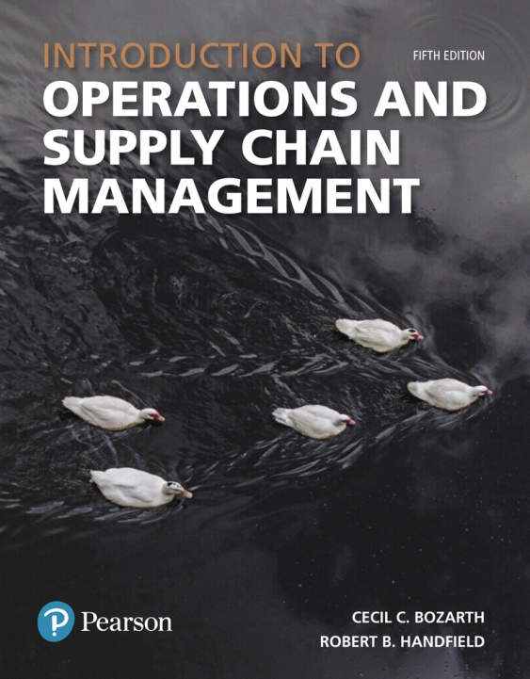
Introduction to Operations and Supply Chain Management
Fifth Edition
Chapter 11
Managing Inventory throughout the Supply Chain
Copyright © 2019, 2016, 2014 Pearson Education, Inc. All Rights Reserved.

Slide 2
Chapter Objectives
11.1 The Role of Inventory
11.2 Periodic Review Systems
11.3 Continuous Review Systems
11.4 Single- Period Inventory Systems
11.5 Inventory in the Supply Chain

Slide 3
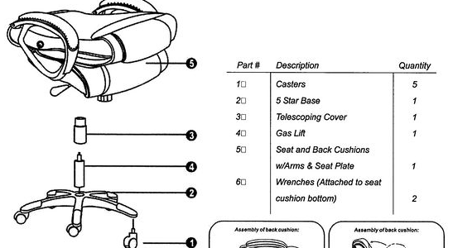
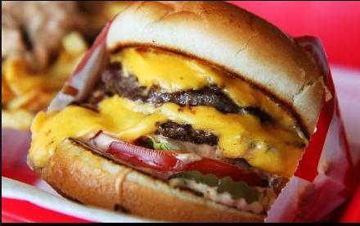
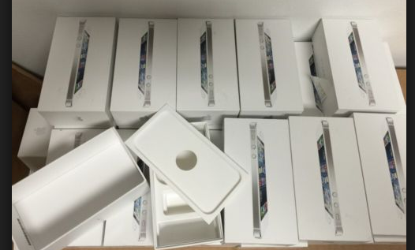
Inventory Management
Inventory – Those stocks or items used to support production (raw materials and work-in-process items), supporting activities (maintenance, repair, and operating supplies) and customer service (finished goods and spare parts).
Examples of Inventory????

Slide 4
Inventory Types
Cycle stock
Safety stock
Anticipation inventory
Hedge inventory
Transportation inventory
Smoothing inventory

Slide 5
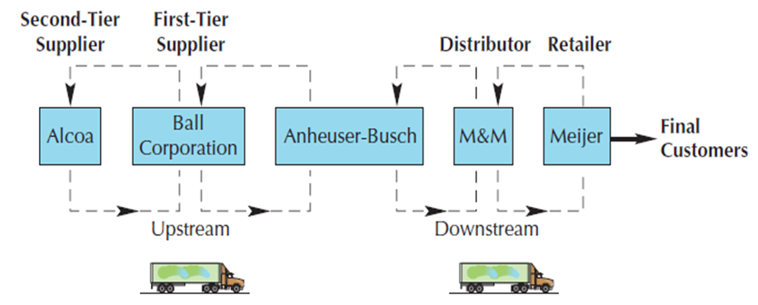
Types of Inventory
Cycle stock – Components or products that are received in bulk by a downstream partner, gradually used up, and then replenished again in bulk by an upstream partner.
Safety stock – Extra inventory that a company holds to protect itself against uncertainties in either demand or replenishment time.

Slide 6
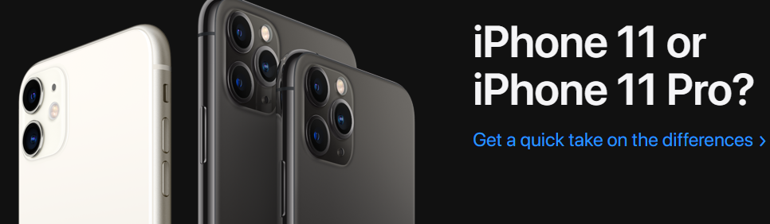
Types of Inventory
Anticipation inventory – Inventory that is held in anticipation of customer demand.
Hedge inventory – A form of inventory buildup to buffer against some event that may not happen.
IE FUEL COST IN SUMMER MONTHS
FOOD ITEMS AT A RESTAURANT

Slide 7
Types of Inventory
Transportation inventory – Inventory that is moving from one link in the supply chain to another.
Smoothing inventory – Inventory that is used to smooth out differences between upstream production levels and downstream demand.

Slide 8
Inventory Drivers
Supply Uncertainty – The risk of interruptions in the flow of components from upstream suppliers. EXAMPLES?
Demand Uncertainty – The risk of significant and unpredictable fluctuations in downstream demand. EXAMPLES?

Slide 9
Independent vs.
Dependent Demand Inventory
Independent demand inventory – Inventory items whose demand levels are beyond a company’s complete control. NOT FULLY PREDICABLE
  Independent demand:
    Client demand, demand for repair and maintenance.
Dependent demand inventory – Inventory items whose demand levels are tied directly to a company’s planned production of another item.
  Dependent demand:
    Kitchen table legs – Need 4 per table or 2,000 legs

Slide 10
Periodic Review System
Periodic Review System – An inventory system that is used to manage independent demand inventory where the inventory level for an item is checked at regular intervals and restocked to some predetermined level.

Slide 11
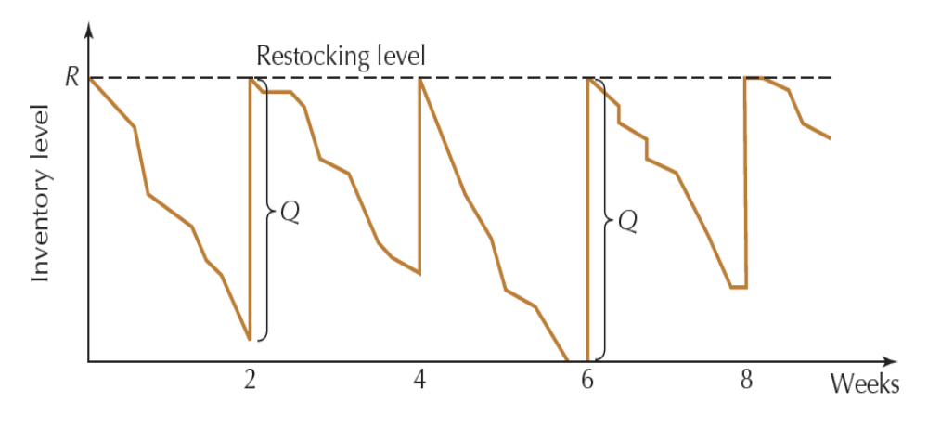
Periodic Review System
Order quantity (Q) = The amount required to bring the inventory level back up to R.
Q = R - I
where
Q = order quantity
R = restocking level
I = inventory level at the time of review.
Figure 11.6

Slide 12
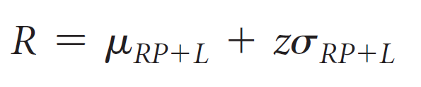
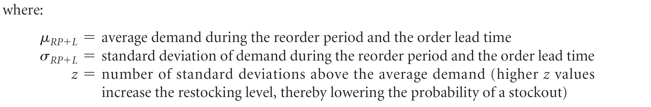
Periodic Review System
Restocking Level (R)

Slide 13
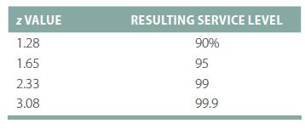
Periodic Review System
Service Level – A term used to indicate the amount of demand to be met under conditions of demand and supply uncertainty.
  Assumes that the demand during the reorder period and the order lead time is normally distributed. Table provided based on statistical data for service level.

Slide 14
Restocking Level Example 11.1 – A&G Chips
Every 10 days, a delivery person stops and checks the inventory level and places an order that is delivered 3 days later.
Average demand during the reorder period is 240 tins.
Order lead time is 13 days total.
Standard deviation of demand during the lead time is 40 tins.
Grocery store wants inventory on hand to meet the demand 95% Meaning that the store is willing to take a 5% chance that product will run out.
Calculate the Restocking Level (R)
R = 240 tins + 1.65 * 40 tins = 306 tins

Slide 15
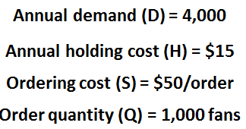
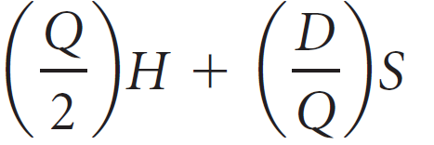
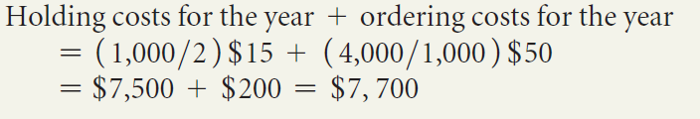
Example 11.2 – Boyer’s Dept Store
Total holding and ordering costs for the year
= total yearly holding cost + total yearly ordering cost =
Yearly holding cost = average inventory level x per-unit holding cost
Yearly ordering cost = number of orders per year x fixed ordering cost

Slide 16
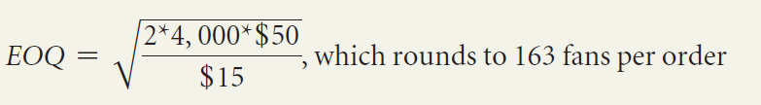


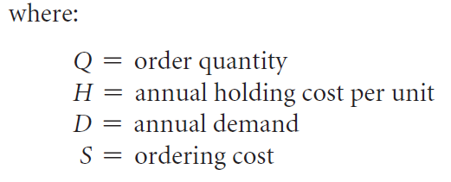

Example 11.2 – Boyer’s Dept Store
Calculate the Economic order quantity (EOQ) and use that value as the order quantity to see if the cost is lower & calculate the total yearly inventory cost.
Cost Savings:
The order quantity that minimizes annual holding and ordering costs for an item.

Slide 17


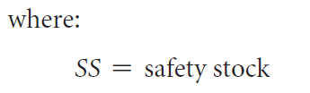
Continuous Review System
Reorder Point (ROP)
  When demand rate (d) and lead time (L) are constant:
  When demand rate (d) and lead time (L) or both varies:

Slide 18
Continuous Review System
The decision of how much safety stock to hold depends on five factors:
  The variability of demand
  The variability of lead time
  The average length of lead time
  The desired service level
  The average demand

Slide 19
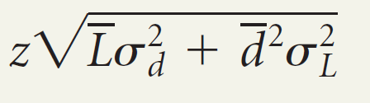
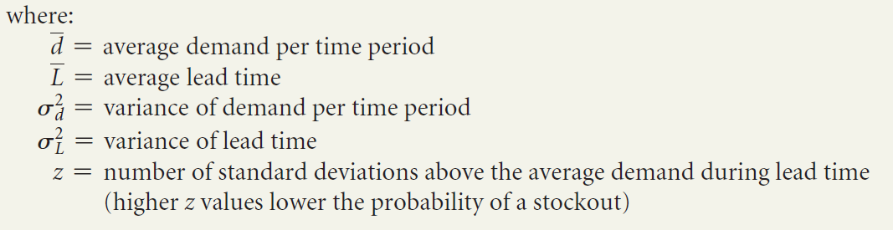
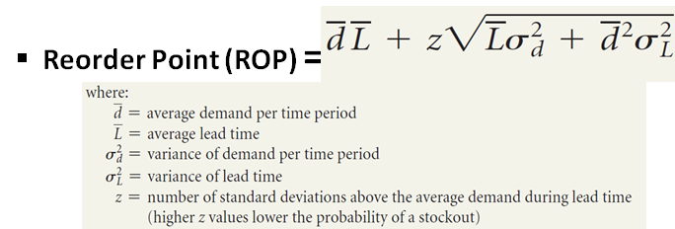
Example of Re-Order Point & Safety Stock
Safety Stock (SS) =

Slide 20
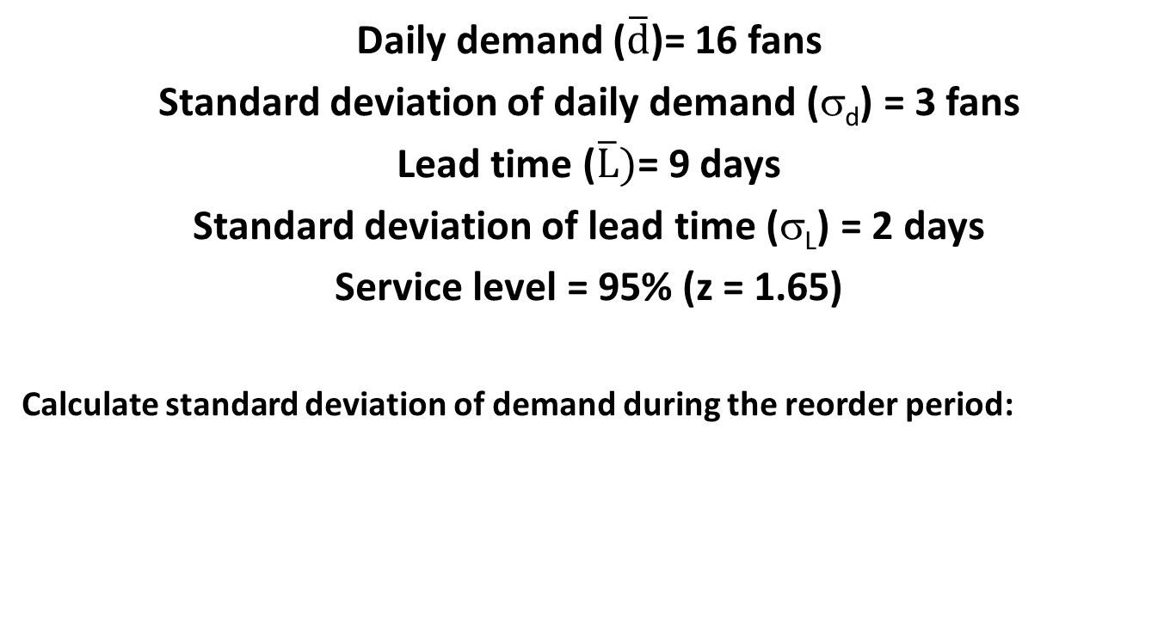
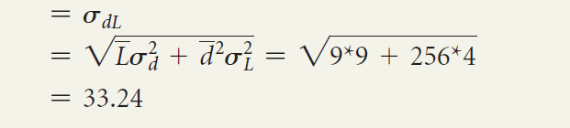
Example 11.3 – Boyer’s Dept Store

Slide 21

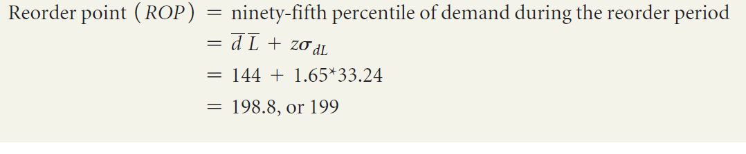
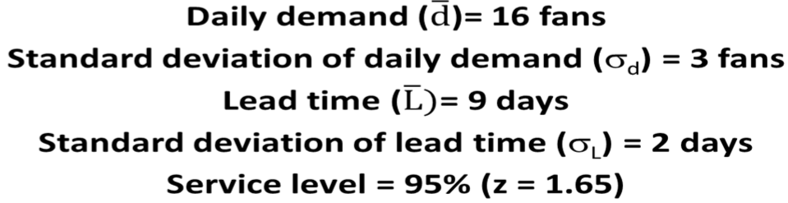
Example 11.3 – Boyer’s Dept Store
Calculate Safety Stock:
Calculate Reorder Point:

Slide 22
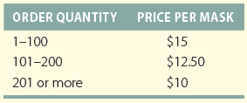
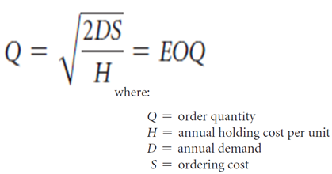
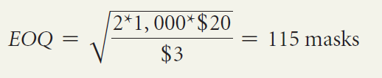
Example 11.4 – Hal’s Magic Shop
Demand (D) = 1,000 masks
Ordering cost (S) = $20
Holding cost (H) = $3
Solve for Economic order quantity (EOQ) :

Slide 23
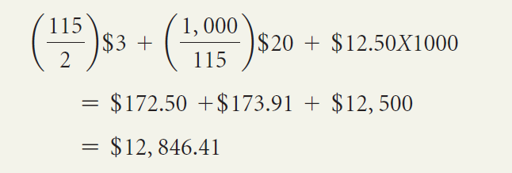
Example 11.4 – Hal’s Magic Shop
Because 115 is not eligible for the lowest price, calculate total cost at 115:
Demand (D) = 1,000 masks
Ordering cost (S) = $20
Holding cost (H) = $3
Quantity (Q)=115

Slide 24
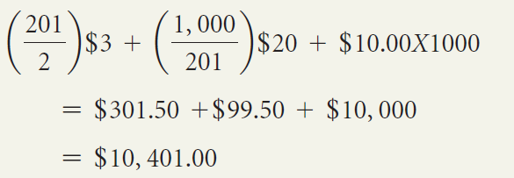
Example 11.4 – Hal’s Magic Shop
And compare to total cost at next price break or 201.
Price is cheaper at the 201 price break.
Below at 101-200

Slide 25
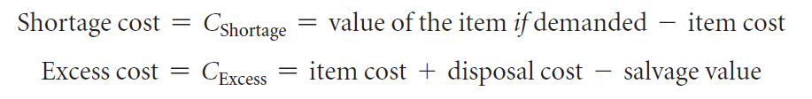
Single-Period Inventory Systems
When excess inventory cannot be held in the future, firms must weigh the cost of being short against the cost of holding excess unit.
The following costs are calculated:

Slide 26
Single-Period Inventory Systems
Single-period inventory system – A system used when demand occurs in only a single point in time. IE Fresh seafood. Must be used.
Two-step process:
  Determine a target service level (SL_{T}) that strikes the best balance between shortage costs and excess costs.
  Use the target service level to determine the target stocking point (TS) for the item.
Target service level – The service level at which the expected cost of a shortage equals the expected cost of having excess units.
Target stocking point – The stocking point at which the expected cost of a shortage equals the expected cost of having excess units.

Slide 27
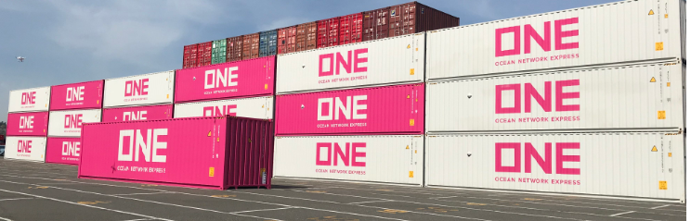
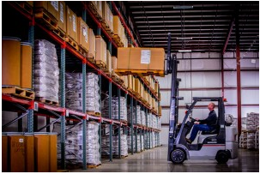
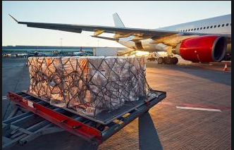
Inventory in the Supply Chain
Inventory Positioning – Deciding where in the supply chain to hold inventory.
  The cost and value of inventory increase as materials move down the supply chain.
  The flexibility of inventory decreases as materials move down the supply chain.
    Inventory Pooling – Holding safety stock in a single location instead of multiple locations.
Transportation, Packaging and Material Handling Considerations

Slide 28
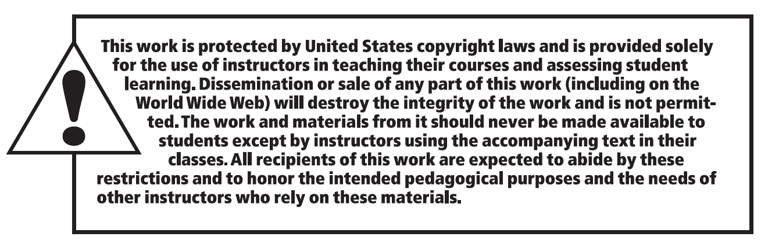
Copyright

